Slide 1
Assessing the Economic Impact of Obesity and Overweight on Employers: Identifying Paths Toward Work Force Health and Well-Being
Supported by Eli Lilly and Company
February 2024
See the full report at:
https://www.globaldata.com/health-economics/US

Slide 2
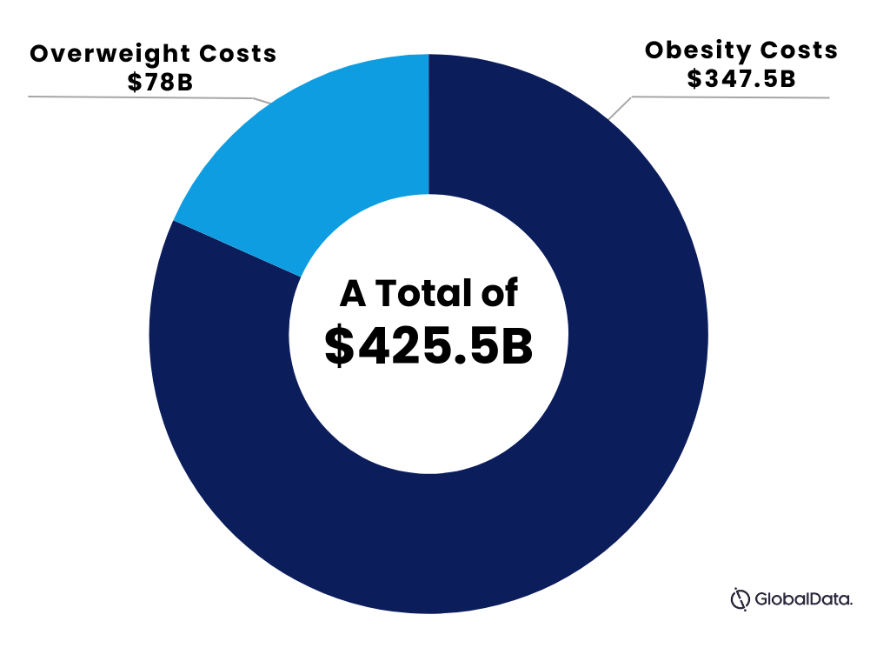

Economic Costs to Employers & Employees

Slide 3
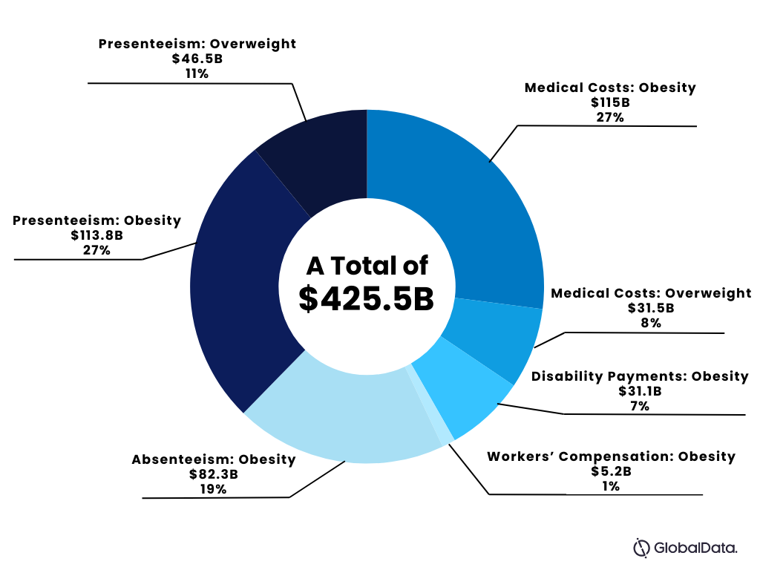
Economic Costs to Employers & Employees

Slide 4
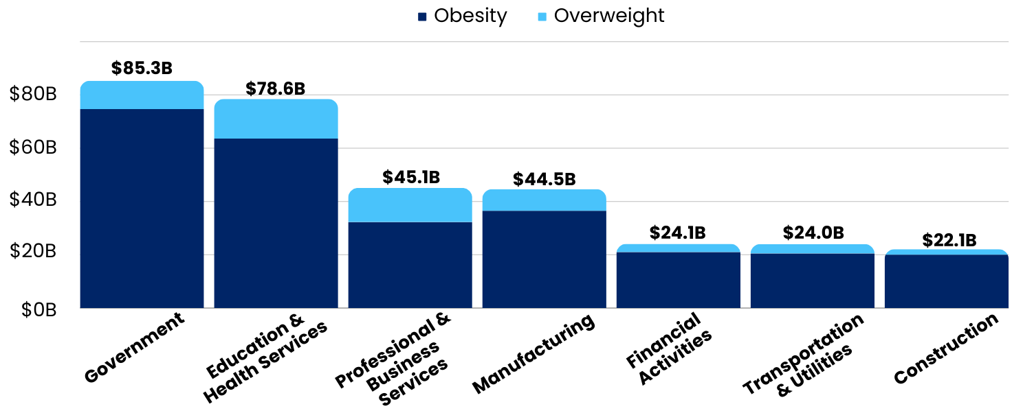
Economic Impact of Excess Body Weight For Select Industries
The economic impact differs by industry based on obesity prevalence, demographics, industry-specific risks, and socioeconomic factors

Slide 5



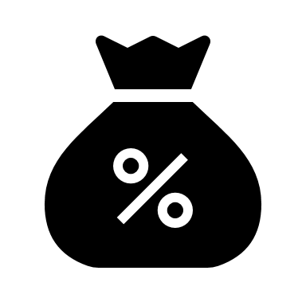

FACTORS IMPACTED BY WORKFORCE
ANNUAL COST PER WORKER WITH OBESITY
AGGREGATE COSTS
$89.8B
$56.7B
$1,514
Employers
Employees
Higher Medical Costs
$115.0B
$31.5B
Obesity
Overweight
Higher Disability​
$664
$31.1B
Higher Injury Worker Compensation
$112
$5.2B
Higher Health-Related Work Absenteeism
$1,755
$82.3B
Higher Health-Related Work Presenteeism
$2,427
$113.8B
$46.5B
Obesity
Overweight

Slide 6
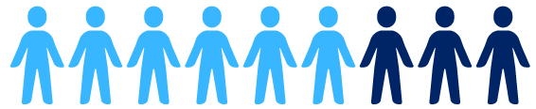
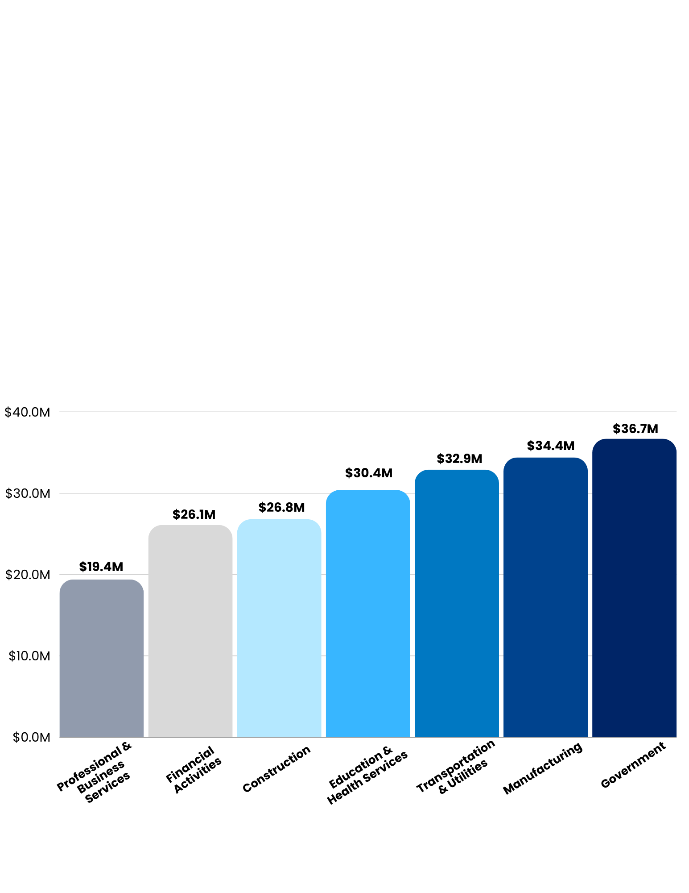
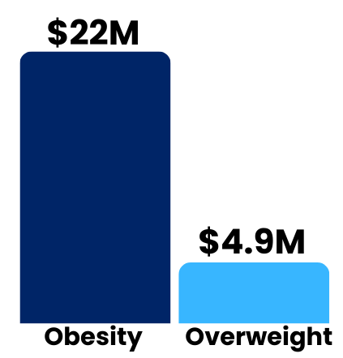
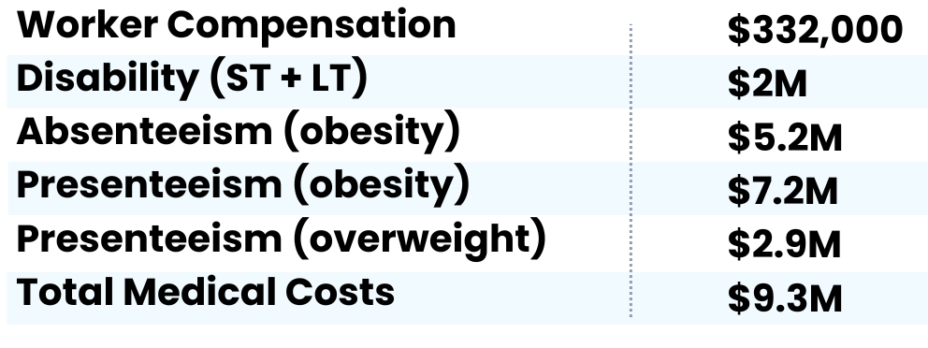
Costs Per Organization With 10,000 Employees (Plus Dependents)
Employees with Obesity (30%) & Overweight (34%)
Impact of Excess Body weight by Modeled Industry
Total Costs
Obesity Cost Components

Slide 7
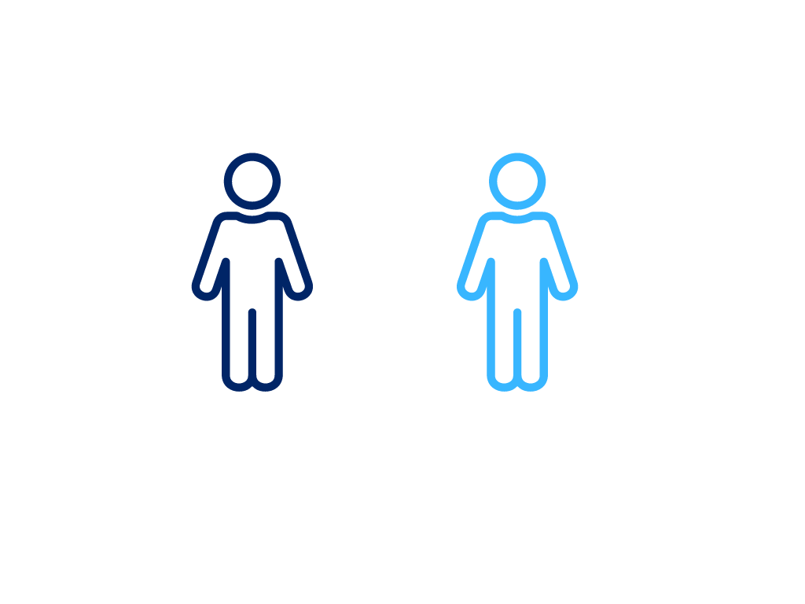
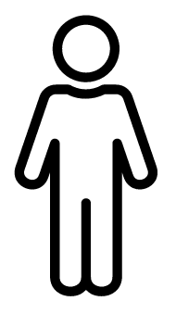
Annual Average Cost of Obesity or Overweight
Employees
Adult Dependents
$6,472
Per Person with Obesity
$1,244
Per Person with Overweight
$1,514
Per Person with Obesity
$380
Per Person with Overweight

Slide 8
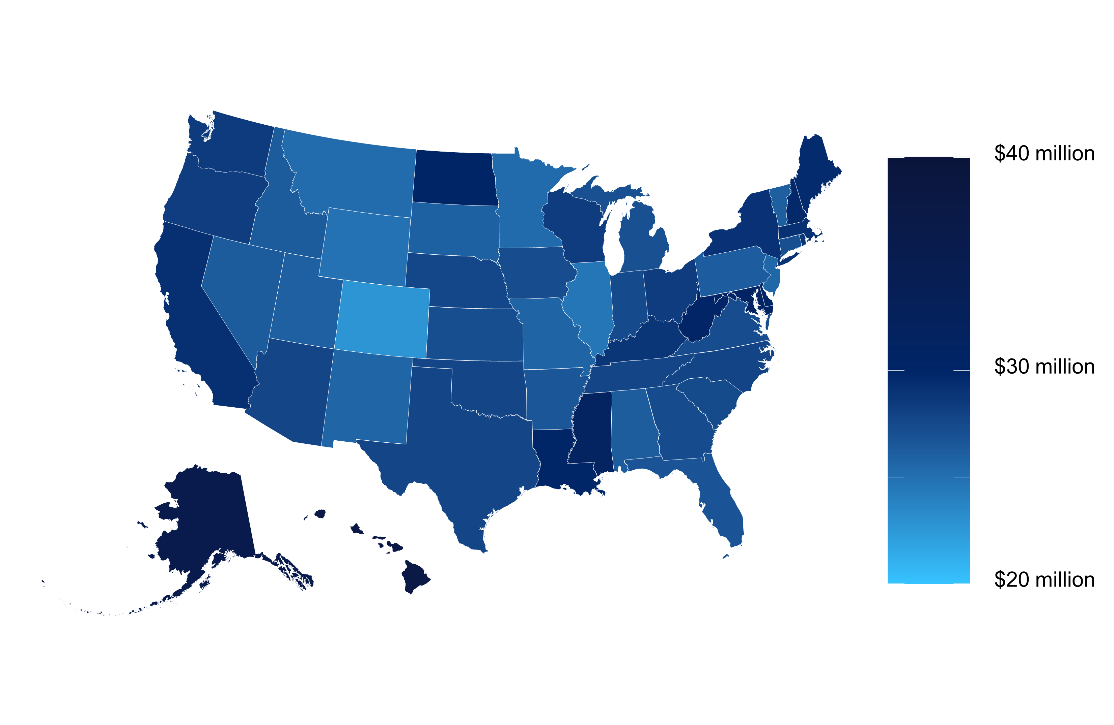
State Variation in the Annual Cost Excess Weight per 10,000 Employees
Estimated annual cost of excess weight for a hypothetical organization based on nationally represented industry mix
State differences from geographic variation in:
Obesity prevalence
Demographics
Economic factors
**Costs range from $22.7M in Colorado to $37.6M in Hawaii

Slide 9

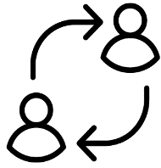
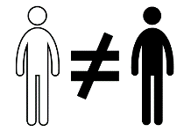





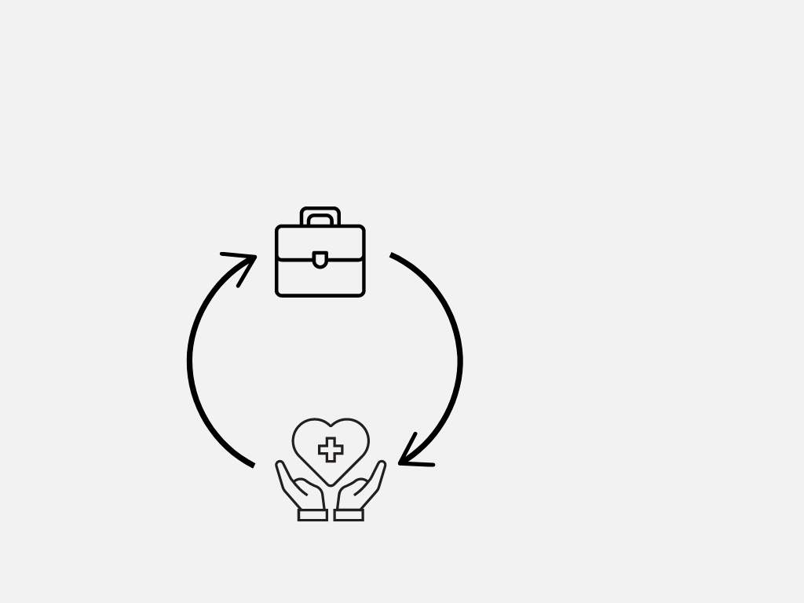
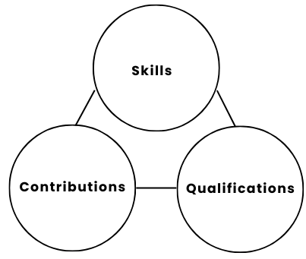
Other Workforce Implications
Labor Force Participation
Career Advancement
Workforce Resilience
Turnover
Hiring
Men with obesity have 7% lower odds of being employed compared to healthy weight men
Women with obesity have 20% lower odds of being employed compared to healthy weight women
If Employers Prioritize:
Findings revealed
Individuals with higher BMI face stereotypes may impact length of unemployment
Long-Term Organizational Success
Physical health and safety
Higher BMI
Acute respiratory illnesses
Mental health and stress
Bias
Discrimination
Diminished Satisfaction with Work Life
Employment status more correlated with individual’s health than social discrimination
Discrimination
Retained talent
Maintain high levels of productivity
Employee satisfaction
Litigation & more costs
Hinder progression in hiring stages
Increased Turnover
**Characteristics to focus on rather than physical attributes

Slide 10
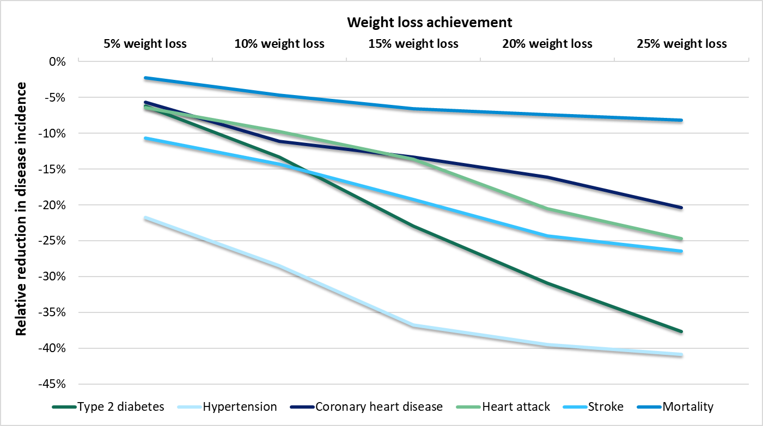
Estimated 5-year Clinical Benefits of Weight Loss for Adults with Obesity (All Industries)

Slide 11
Estimated Aggregate Medical Savings Due to Weight Loss per Individual with Obesity (All Industries)

Slide 12
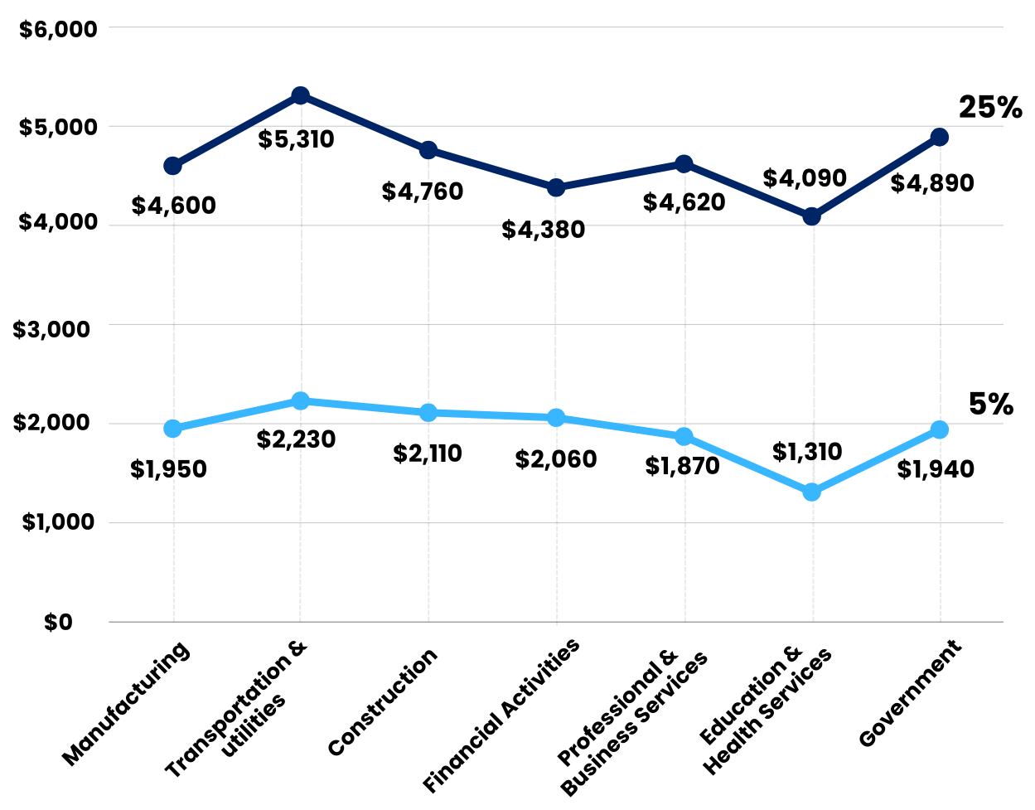
5-year Aggregate Medical Savings Due to Weight Loss per Individual with Obesity
5% to 25% weight loss among employees and adult dependents with obesity has the potential to save $153.3B-$326.1B in medical costs cumulative over 5 years
Potential Medical Industry Savings

Slide 13
Estimated Aggregate Medical Savings Due to Weight Loss per Individual with Class 3* Obesity (All Industries)
* Class 3 Obesity is defined as BMI of 40 kg/m2 or higher.

Slide 14












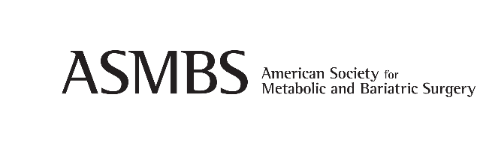


TREATMENT OPTIONS
Evidence-based Options for Treating or Preventing Obesity
Examples of Organizations with Obesity Treatment Guidelines
Recommendations
Employers can increase treatment access by…
Lifestyle and behavioral interventions
Opt-in to comprehensive obesity insurance coverage and wellness programs for obesity care at parity with other chronic diseases
and
Medical treatments
Upgrade, implement, or incent use of wellness programs
Foster a culture of support and inclusion
Prescription Anti-obesity Medications
Bariatric Surgery
Provide education and resources

Slide 15
APPENDICES

Slide 16
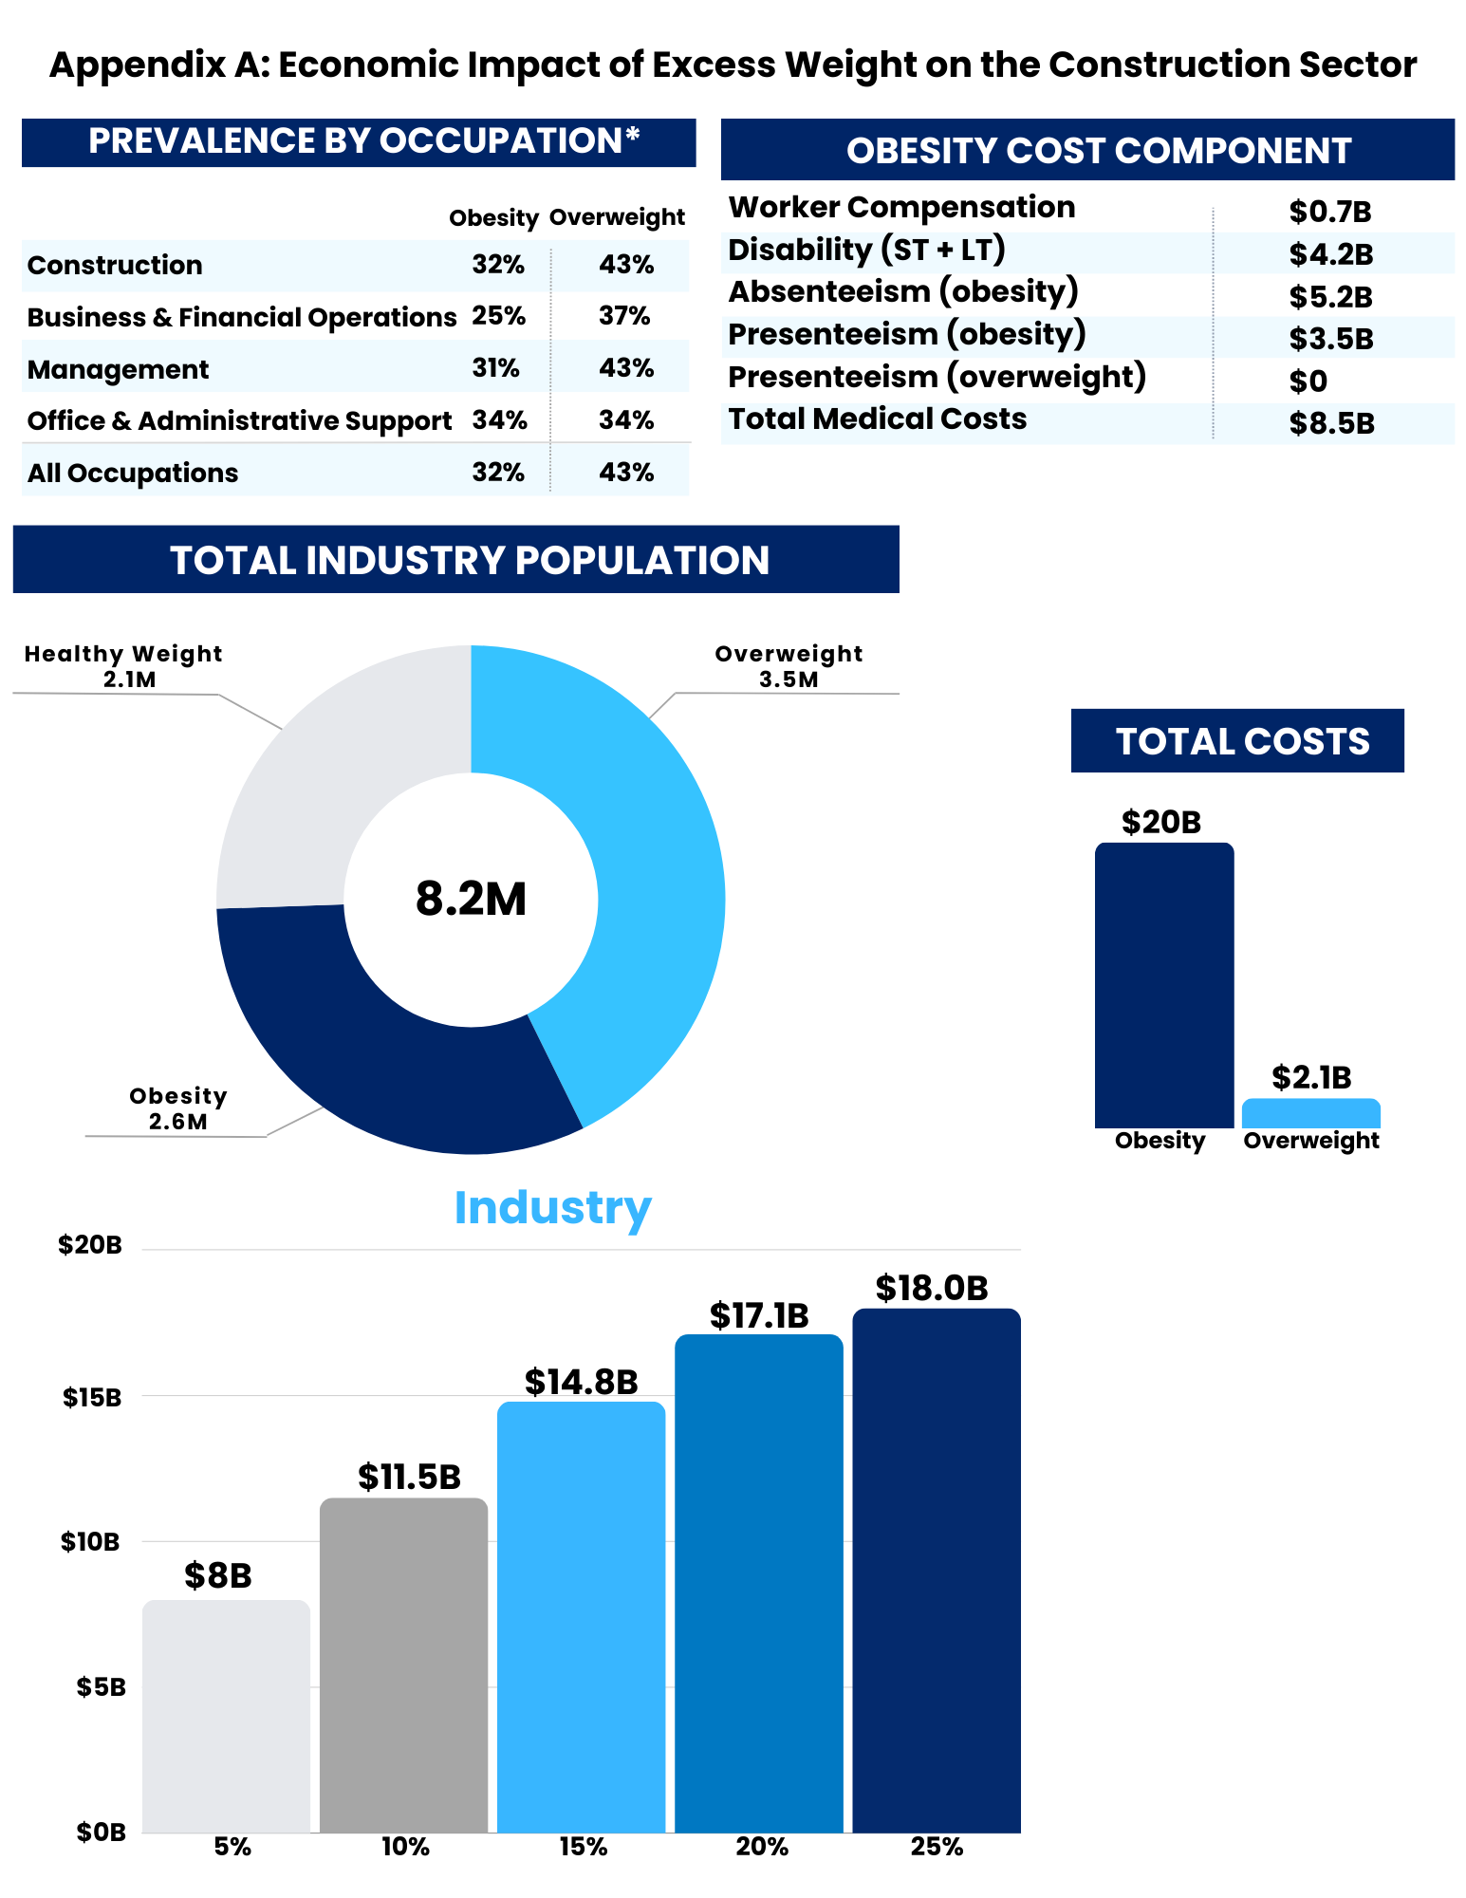
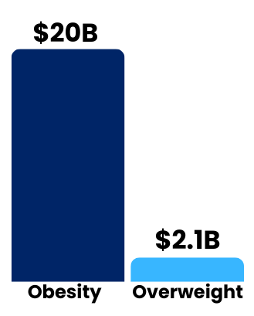
Appendix A: Economic Impact of Excess Weight on the Construction Sector
Total Employees
Total Costs

Slide 17
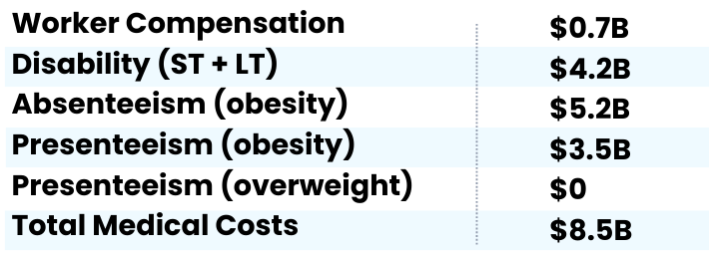
Appendix A: Economic Impact of Excess Weight on the Construction Sector
Prevalence by Occupation*
Obesity Cost Component
* Estimated using the 2015-2018 National Health Interview Survey; estimates are based on self-reported weight and height, so obesity prevalence might be biased low.

Slide 18
Appendix A: Economic Impact of Excess Weight on the Construction Sector
Estimated Aggregate Medical Savings Due to Weight Loss per Individual with Obesity

Slide 19

Appendix A: Economic Impact of Excess Weight on the Construction Sector
Estimated 5-year Aggregate Medical Cost Savings
Note: Estimated 5-year aggregate medical savings if people with obesity achieved and maintained 5-25% body weight loss.

Slide 20
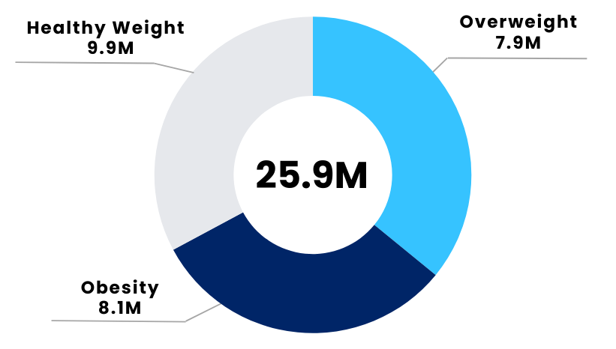
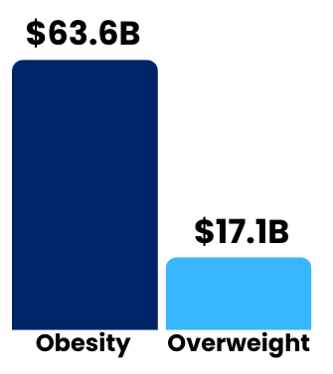
Appendix B: Economic Impact of Excess Weight on the Education and Health Sector
Total Employees
Total Costs

Slide 21
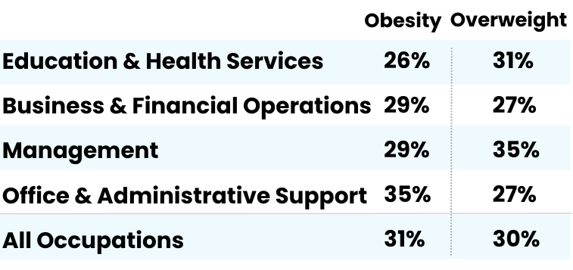

Appendix B: Economic Impact of Excess Weight on the Education and Health Sector
Prevalence by Occupation*
Obesity Cost Component
* Estimated using the 2015-2018 National Health Interview Survey; estimates are based on self-reported weight and height, so obesity prevalence might be biased low.

Slide 22
Appendix B: Economic Impact of Excess Weight on the Education and Health Sector
Estimated Aggregate Medical Savings Due to Weight Loss per Individual with Obesity

Slide 23
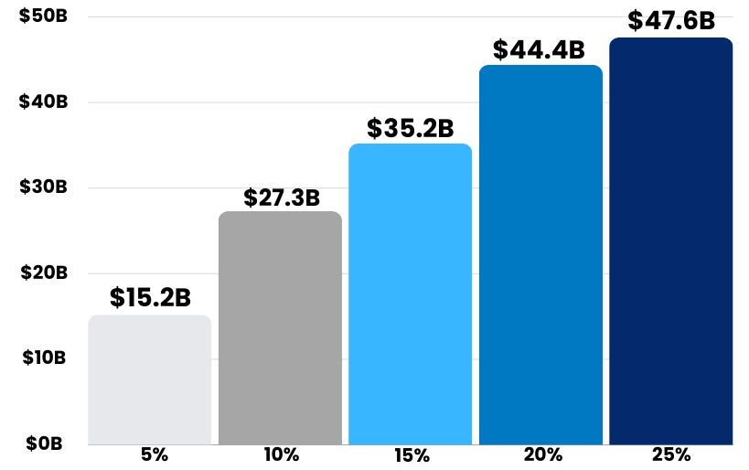
Appendix B: Economic Impact of Excess Weight on the Education and Health Sector
Estimated 5-year Aggregate Medical Cost Savings
Note: Estimated 5-year aggregate medical savings if people with obesity achieved and maintained 5-25% body weight loss.

Slide 24
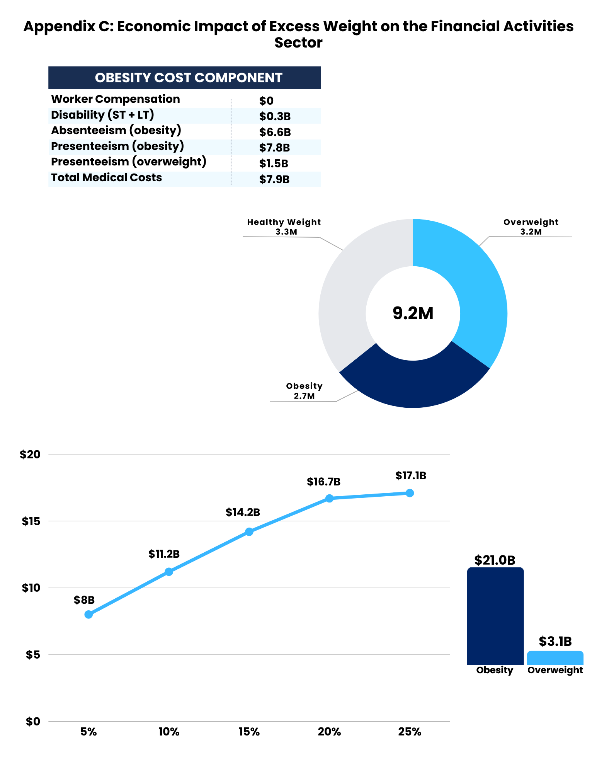
Appendix C: Economic Impact of Excess Weight on the Financial Activities Sector
Total Employees
Total Costs

Slide 25
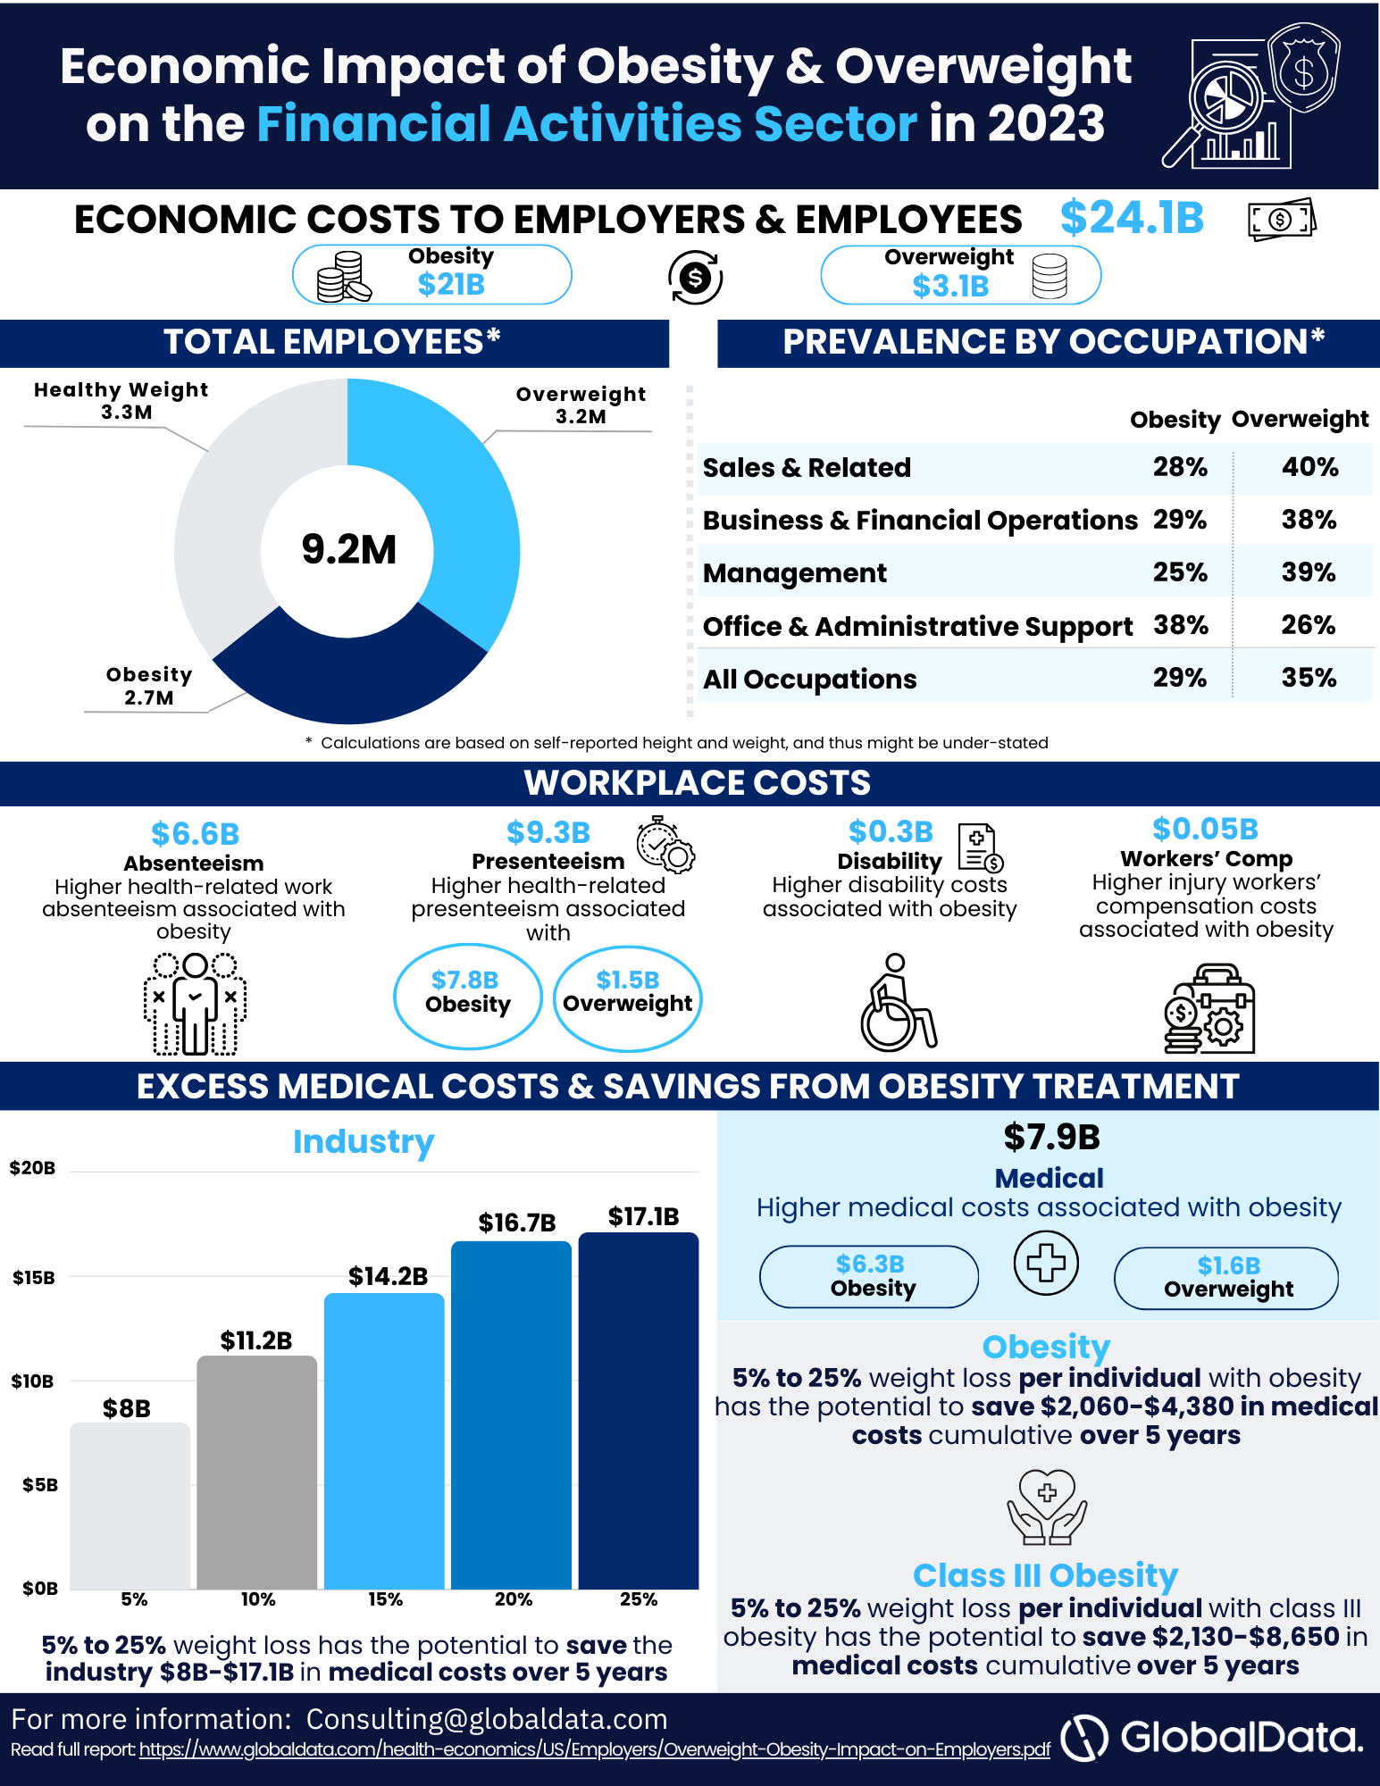
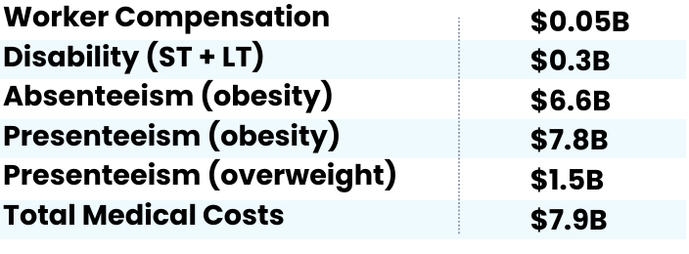
Appendix C: Economic Impact of Excess Weight on the Financial Activities Sector
Prevalence by Occupation*
Obesity Cost Component
* Estimated using the 2015-2018 National Health Interview Survey; estimates are based on self-reported weight and height, so obesity prevalence might be biased low.

Slide 26
Appendix C: Economic Impact of Excess Weight on the Financial Activities Sector
Estimated Aggregate Medical Savings Due to Weight Loss per Individual with Obesity

Slide 27
Appendix C: Economic Impact of Excess Weight on the Financial Activities Sector
Estimated 5-year Aggregate Medical Cost Savings
Note: Estimated 5-year aggregate medical savings if people with obesity achieved and maintained 5-25% body weight loss.

Slide 28
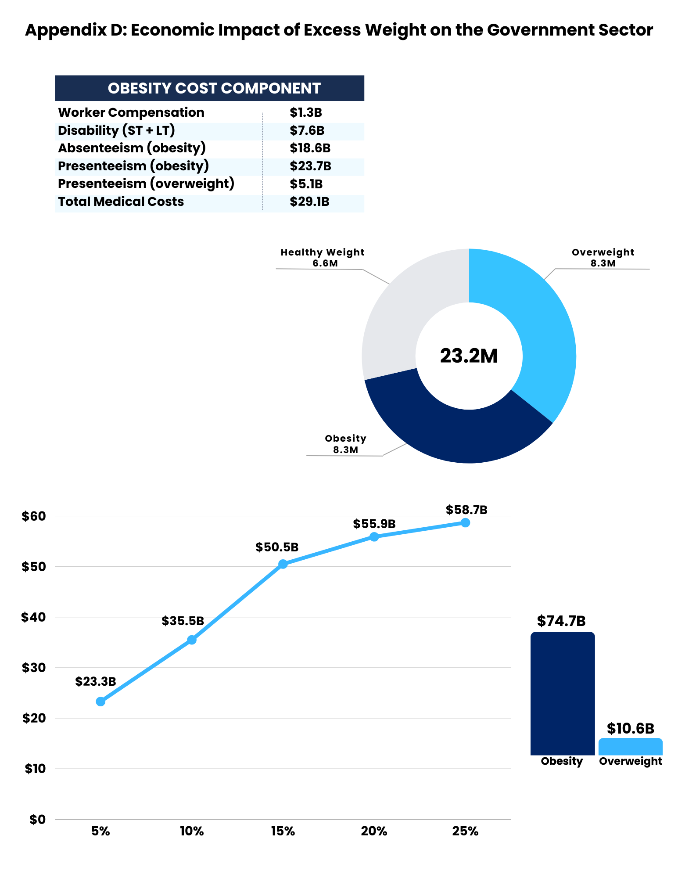
Appendix D: Economic Impact of Excess Weight on the Government Sector
Total Employees
Total Costs

Slide 29
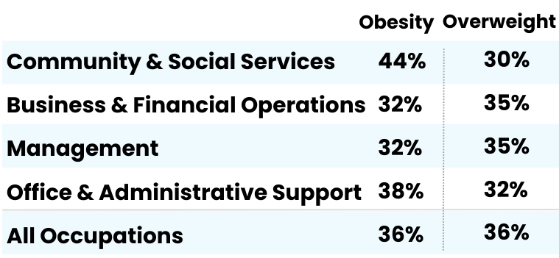
Appendix D: Economic Impact of Excess Weight on the Government Sector
Prevalence by Occupation*
Obesity Cost Component
* Estimated using the 2015-2018 National Health Interview Survey; estimates are based on self-reported weight and height, so obesity prevalence might be biased low.

Slide 30
Appendix D: Economic Impact of Excess Weight on the Government Sector
Estimated Aggregate Medical Savings Due to Weight Loss per Individual with Obesity

Slide 31
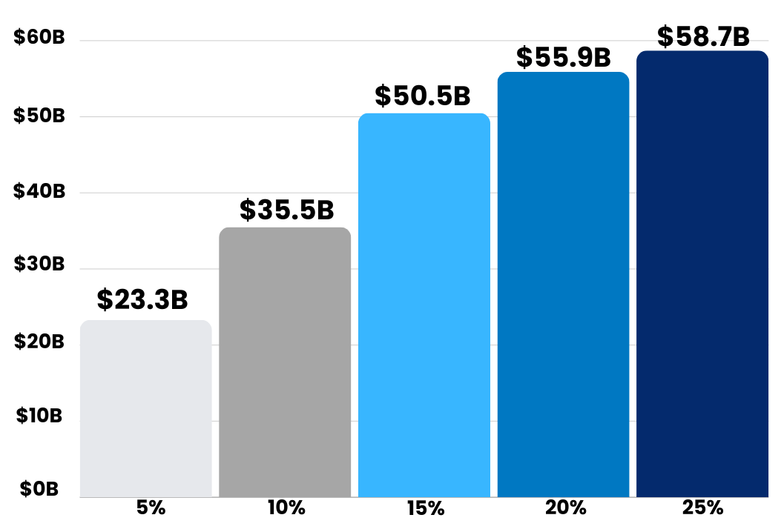
Appendix D: Economic Impact of Excess Weight on the Government Sector
Estimated 5-year Aggregate Medical Cost Savings
Note: Estimated 5-year aggregate medical savings if people with obesity achieved and maintained 5-25% body weight loss.

Slide 32
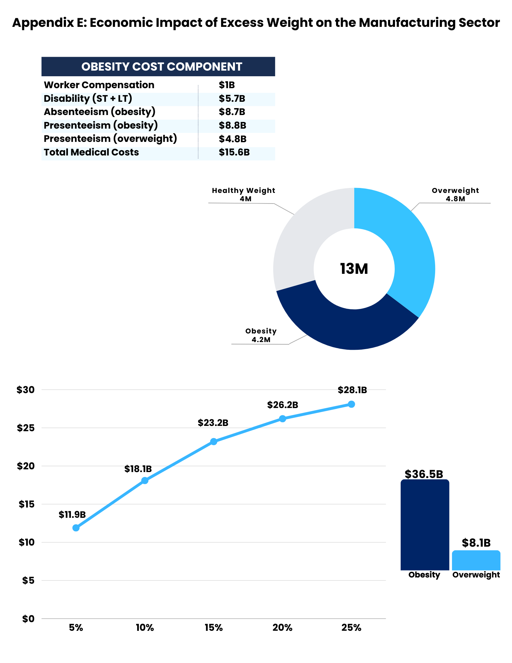
Appendix E: Economic Impact of Excess Weight on the Manufacturing Sector
Total Employees
Total Costs

Slide 33
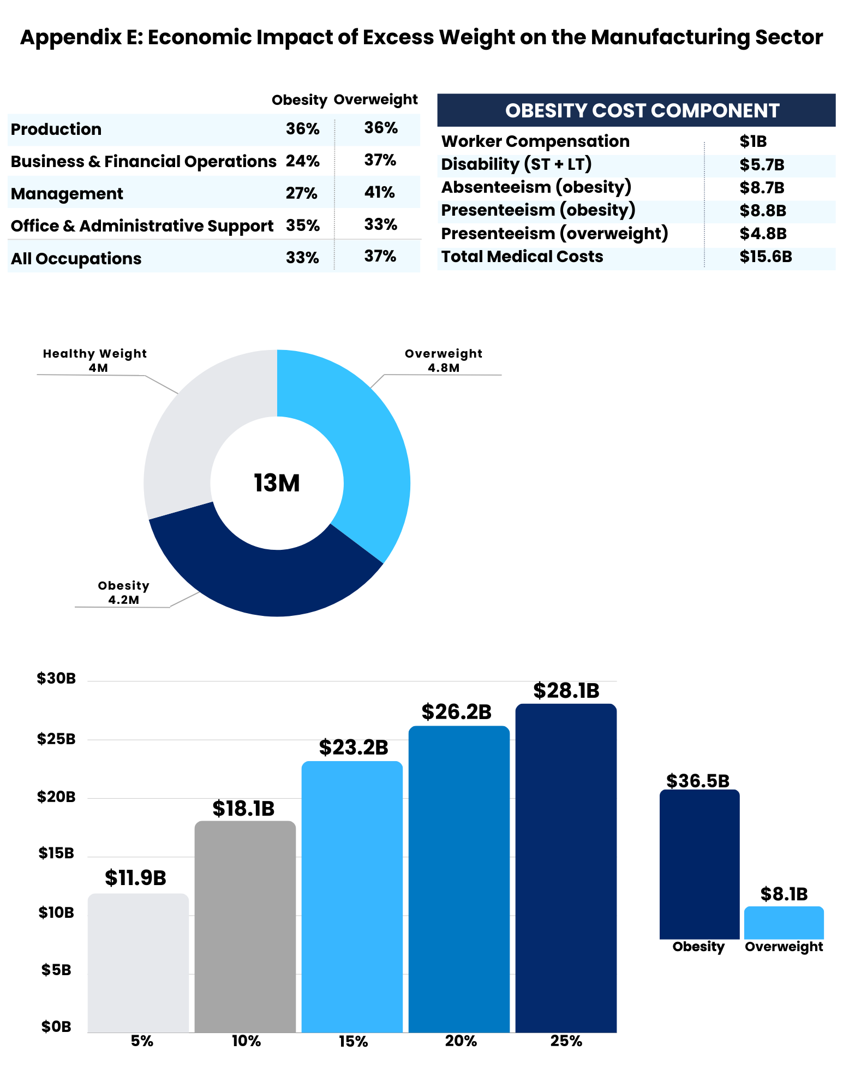
Appendix E: Economic Impact of Excess Weight on the Manufacturing Sector
Prevalence by Occupation*
Obesity Cost Component
* Estimated using the 2015-2018 National Health Interview Survey; estimates are based on self-reported weight and height, so obesity prevalence might be biased low.

Slide 34
Appendix E: Economic Impact of Excess Weight on the Manufacturing Sector
Estimated Aggregate Medical Savings Due to Weight Loss per Individual with Obesity

Slide 35
Appendix E: Economic Impact of Excess Weight on the Manufacturing Sector
Estimated 5-year Aggregate Medical Cost Savings
Note: Estimated 5-year aggregate medical savings if people with obesity achieved and maintained 5-25% body weight loss.

Slide 36
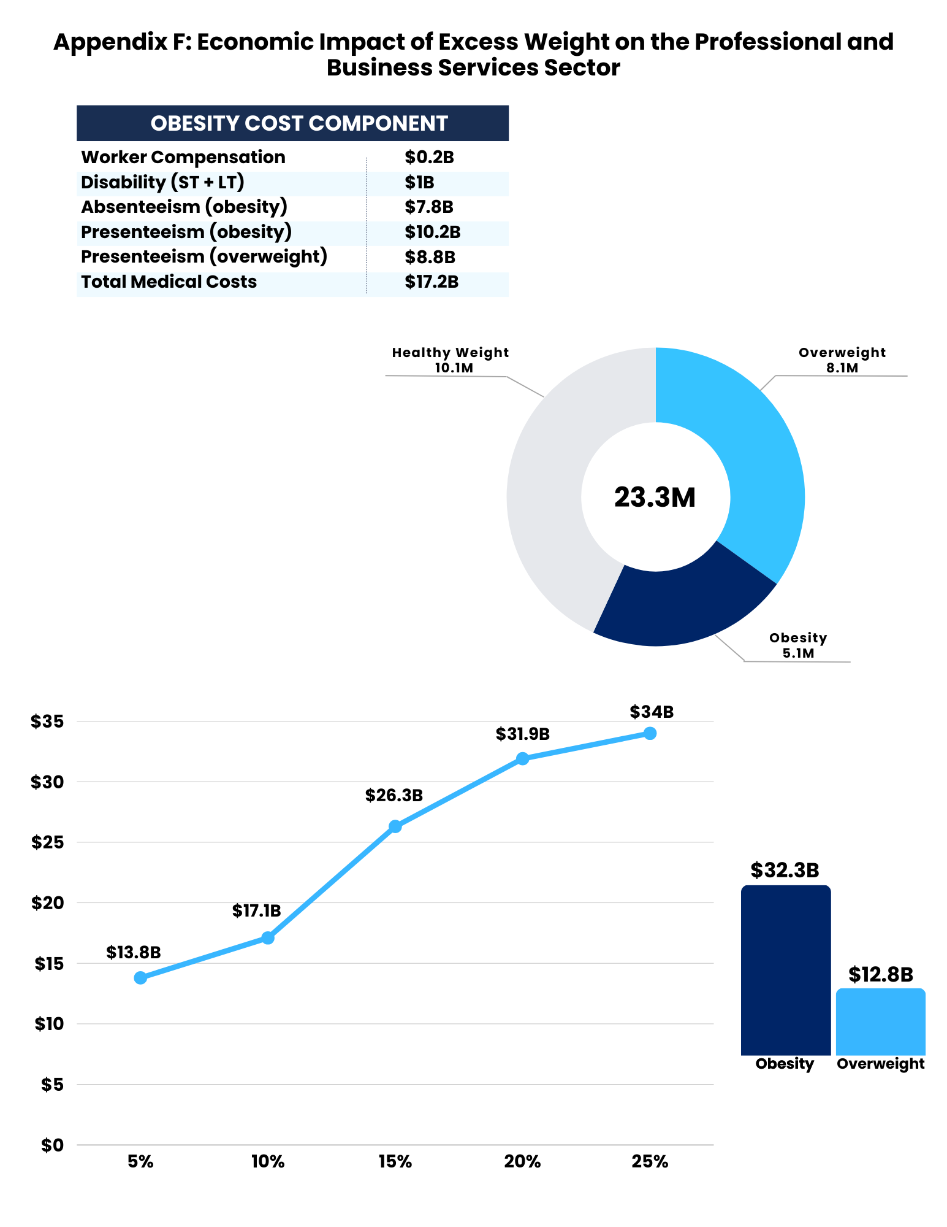

Appendix F: Economic Impact of Excess Weight on the Professional and Business Services Sector
Total Employees
Total Costs

Slide 37
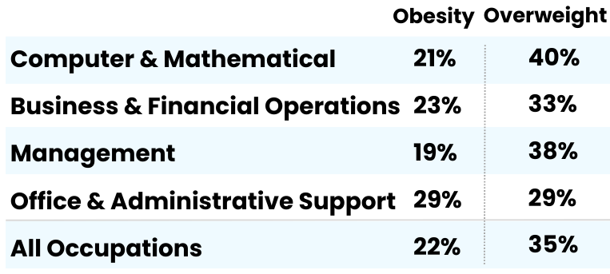
Appendix F: Economic Impact of Excess Weight on the Professional and Business Services Sector
Prevalence by Occupation*
Obesity Cost Component
* Estimated using the 2015-2018 National Health Interview Survey; estimates are based on self-reported weight and height, so obesity prevalence might be biased low.

Slide 38
Appendix F: Economic Impact of Excess Weight on the Professional and Business Services Sector
Estimated Aggregate Medical Savings Due to Weight Loss per Individual with Obesity

Slide 39
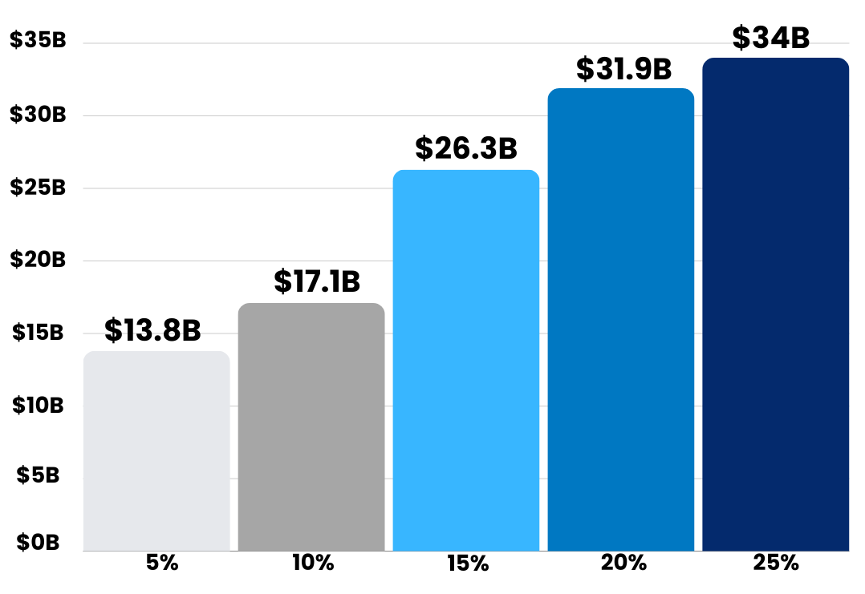
Appendix F: Economic Impact of Excess Weight on the Professional and Business Services Sector
Estimated 5-year Aggregate Medical Cost Savings
Note: Estimated 5-year aggregate medical savings if people with obesity achieved and maintained 5-25% body weight loss.

Slide 40
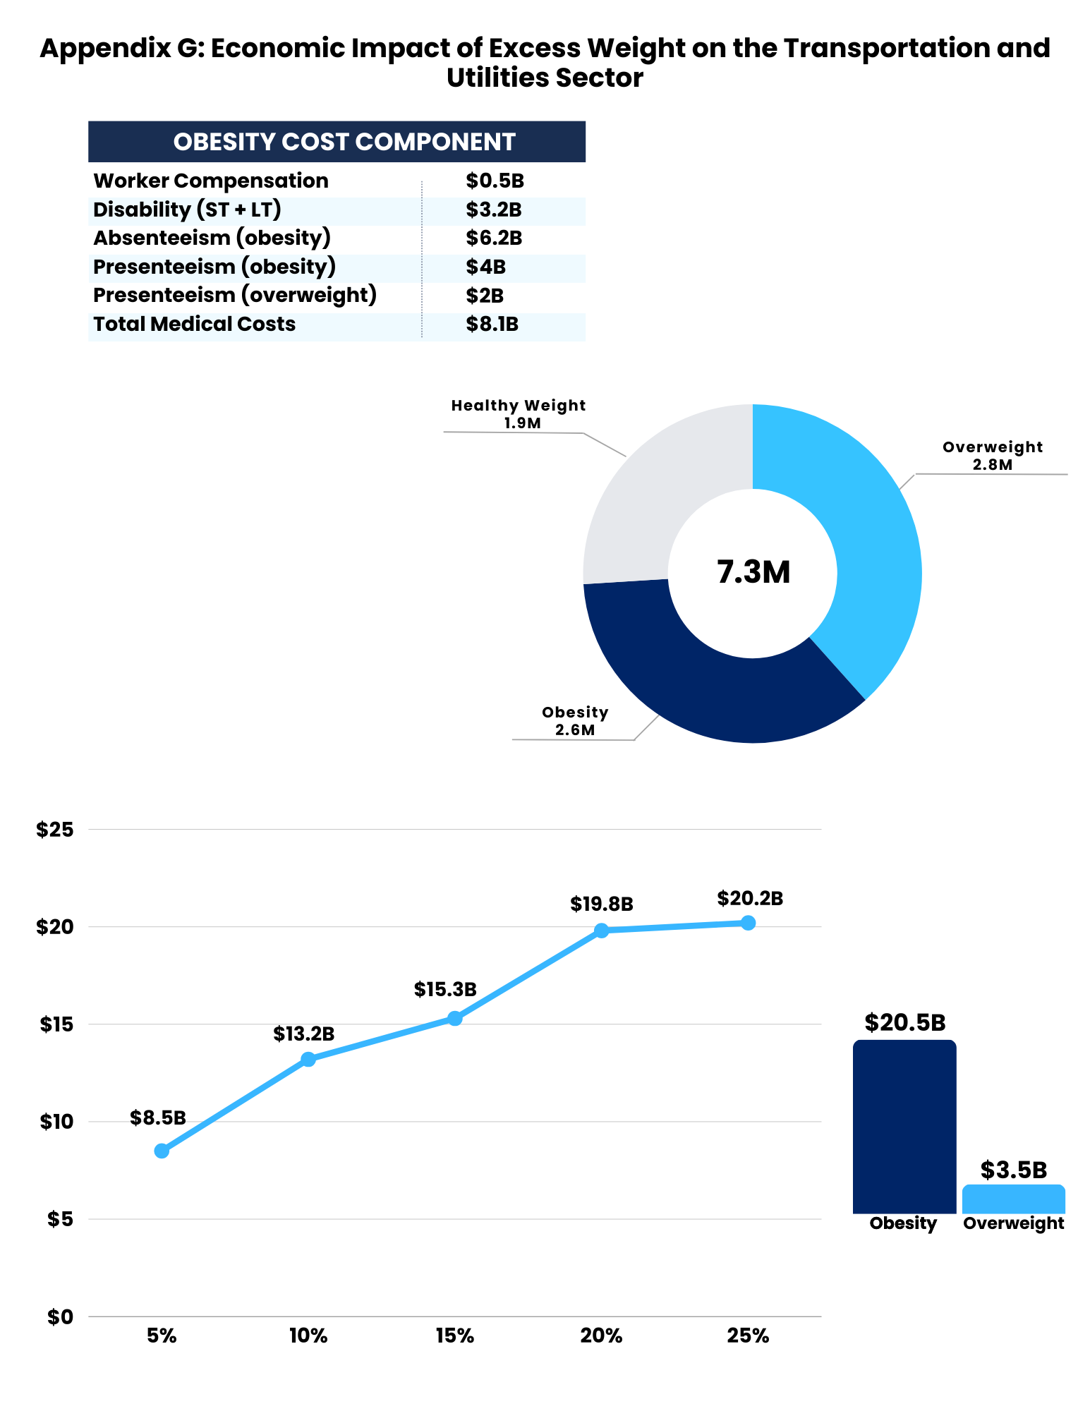
Appendix G: Economic Impact of Excess Weight on the Transportation and Utilities Sector
Total Employees
Total Costs

Slide 41
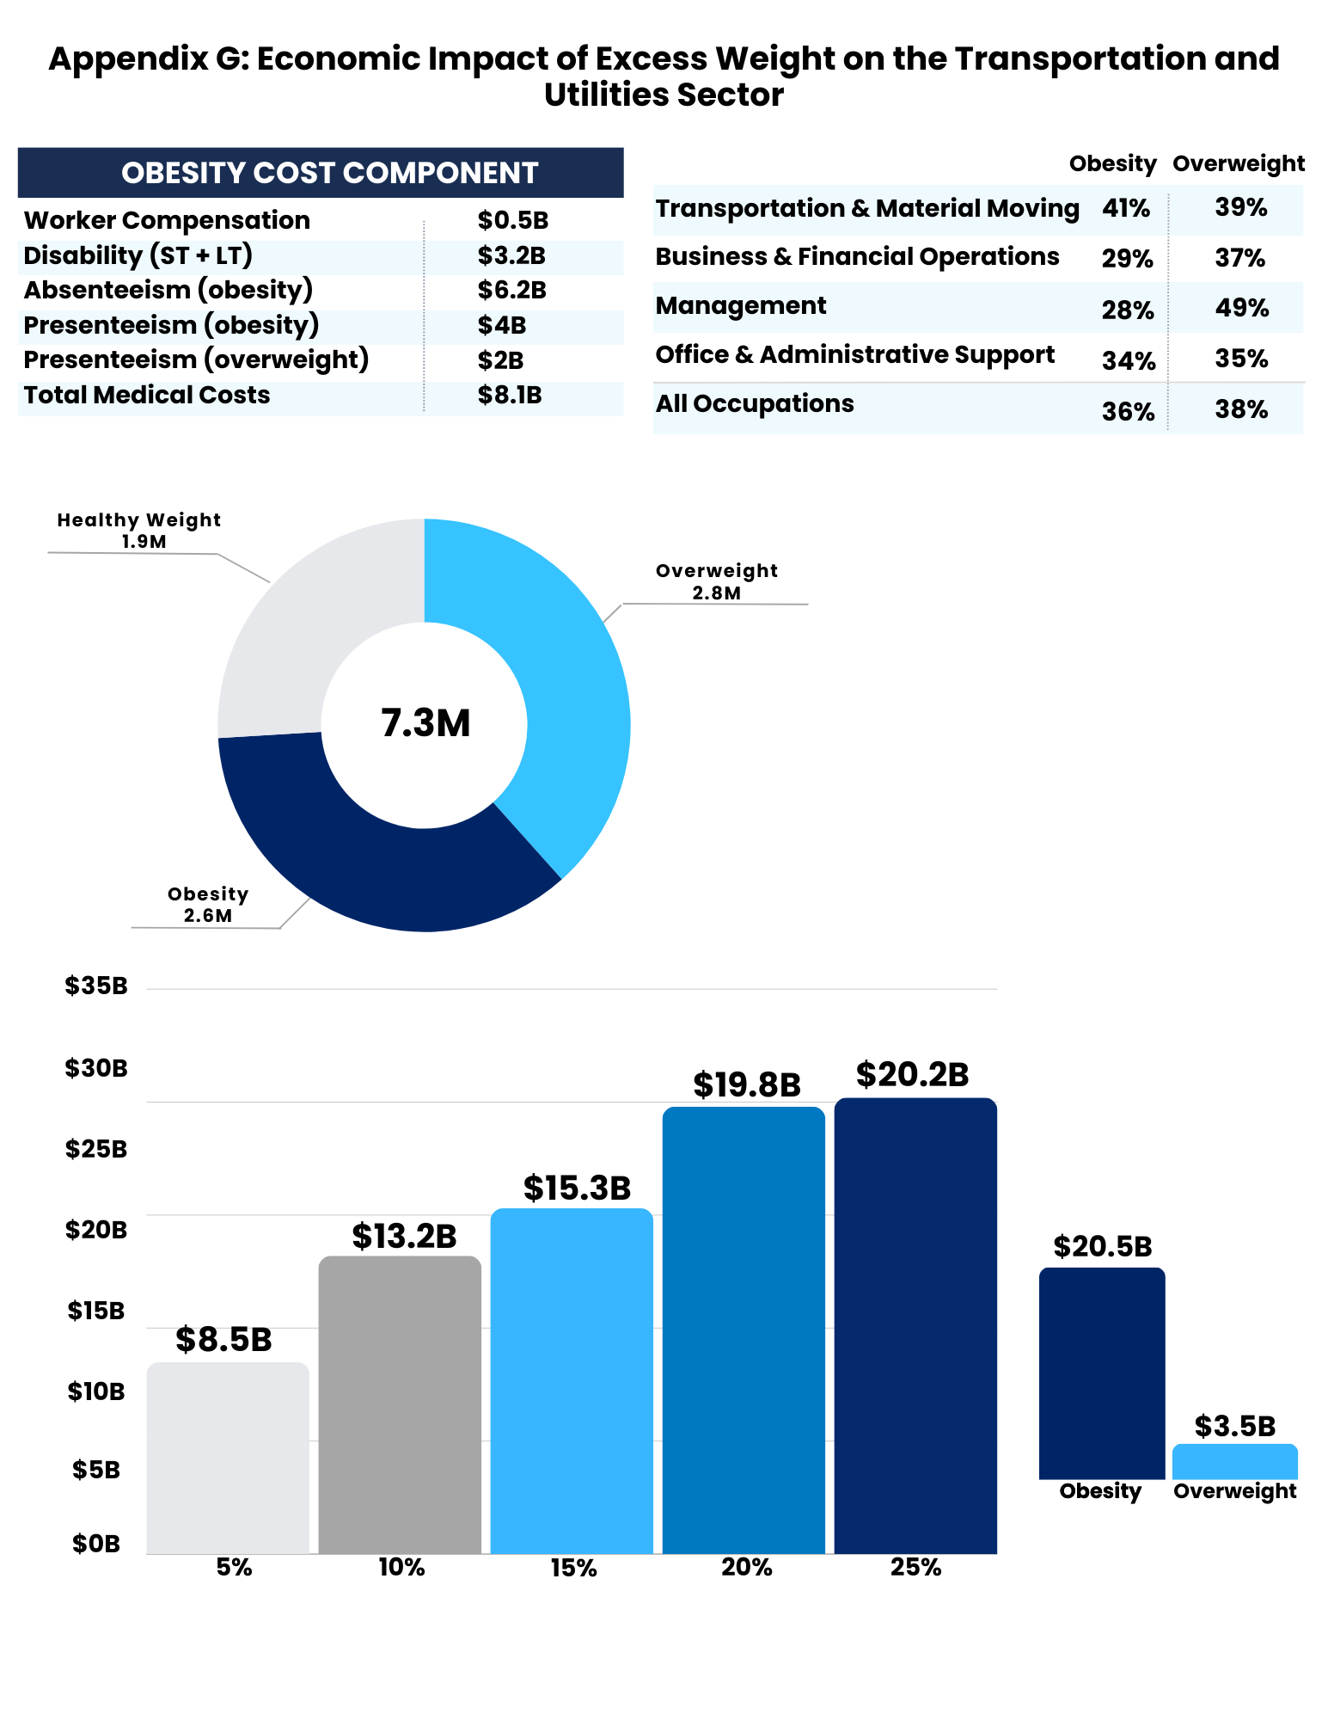
Appendix G: Economic Impact of Excess Weight on the Transportation and Utilities Sector
Excess Medical Costs by Industry
Prevalence by Occupation*
Obesity Cost Component
* Estimated using the 2015-2018 National Health Interview Survey; estimates are based on self-reported weight and height, so obesity prevalence might be biased low.

Slide 42
Appendix G: Economic Impact of Excess Weight on the Transportation and Utilities Sector
Estimated Aggregate Medical Savings Due to Weight Loss per Individual with Obesity

Slide 43
Appendix G: Economic Impact of Excess Weight on the Transportation and Utilities Sector
Estimated 5-year Aggregate Medical Cost Savings
Note: Estimated 5-year aggregate medical savings if people with obesity achieved and maintained 5-25% body weight loss.

Slide 44
Appendix H: State Variation in Cost of Excess Weight to Employers
Cost of Excess Body Weight per Organization with 10,000 Workers, by State ($Million)
 | Higher Health Care Costs | Higher Health Care Costs |  |  | Higher Disability, Worker’s Compensation, and Productivity Costs
State | Total | Total for Employers | Total for Employees | Total for Other Insurers | Disability | Worker’s Compensation | Absenteeism | Presenteeism (Obesity) | Presenteeism (Overweight) | Total
Alabama | $8.95 | $3.88 | $3.51 | $1.56 | $1.96 | $0.33 | $5.17 | $7.15 | $2.63 | $26.18
Alaska | $13.75 | $5.96 | $5.39 | $2.40 | $2.48 | $0.42 | $6.55 | $9.06 | $3.75 | $36.02
Arizona | $8.67 | $3.76 | $3.40 | $1.51 | $2.13 | $0.36 | $5.62 | $7.78 | $3.21 | $27.76
Arkansas | $9.12 | $3.95 | $3.58 | $1.59 | $2.00 | $0.34 | $5.28 | $7.31 | $2.59 | $26.63
California | $8.38 | $3.63 | $3.29 | $1.46 | $2.23 | $0.38 | $5.88 | $8.13 | $4.24 | $29.23
Colorado | $7.19 | $3.12 | $2.82 | $1.26 | $1.65 | $0.28 | $4.36 | $6.03 | $3.17 | $22.68
Connecticut | $8.88 | $3.85 | $3.48 | $1.55 | $1.98 | $0.33 | $5.22 | $7.22 | $3.45 | $27.07
Delaware | $10.63 | $4.61 | $4.17 | $1.86 | $2.23 | $0.38 | $5.88 | $8.14 | $2.82 | $30.08
District of Columbia | $7.55 | $3.27 | $2.96 | $1.32 | $2.00 | $0.34 | $5.29 | $7.31 | $3.78 | $26.26
Florida | $8.96 | $3.88 | $3.51 | $1.56 | $1.98 | $0.33 | $5.23 | $7.24 | $3.01 | $26.76
Georgia | $10.10 | $4.38 | $3.96 | $1.76 | $1.96 | $0.33 | $5.18 | $7.17 | $2.56 | $27.31
Hawaii | $9.89 | $4.28 | $3.88 | $1.73 | $2.99 | $0.50 | $7.91 | $10.94 | $5.35 | $37.58
Idaho | $9.10 | $3.94 | $3.57 | $1.59 | $1.90 | $0.32 | $5.03 | $6.96 | $3.00 | $26.31
Illinois | $8.69 | $3.76 | $3.41 | $1.52 | $1.77 | $0.30 | $4.67 | $6.46 | $2.71 | $24.59
Indiana | $9.93 | $4.30 | $3.90 | $1.73 | $2.00 | $0.34 | $5.29 | $7.32 | $2.54 | $27.43
Iowa | $10.23 | $4.43 | $4.01 | $1.79 | $1.93 | $0.33 | $5.09 | $7.04 | $2.63 | $27.24
Kansas | $10.18 | $4.41 | $3.99 | $1.78 | $1.93 | $0.33 | $5.10 | $7.06 | $2.55 | $27.14
Kentucky | $9.75 | $4.22 | $3.82 | $1.70 | $2.18 | $0.37 | $5.77 | $7.98 | $2.80 | $28.85
Louisiana | $11.14 | $4.83 | $4.37 | $1.95 | $2.16 | $0.36 | $5.72 | $7.91 | $2.65 | $29.94
Maine | $10.29 | $4.46 | $4.03 | $1.80 | $2.18 | $0.37 | $5.75 | $7.95 | $3.04 | $29.57
Maryland | $9.80 | $4.25 | $3.84 | $1.71 | $2.36 | $0.40 | $6.23 | $8.62 | $3.34 | $30.74

Slide 45
Appendix H: Cost of Excess Body Weight per Organization with 10,000 Workers, by State ($Million)
 | Higher Health Care Costs |  |  |  | Higher Disability, Worker’s Compensation, and Productivity Costs
State | Total | Total for Employers | Total for Employees | Total for Other Insurers | Disability | Worker’s Compensation | Absenteeism | Presenteeism (Obesity) | Presenteeism (Overweight) | Total
Massachusetts | $8.22 | $3.56 | $3.23 | $1.44 | $2.24 | $0.38 | $5.93 | $8.20 | $4.19 | $29.16
Michigan | $9.67 | $4.19 | $3.79 | $1.69 | $1.99 | $0.34 | $5.25 | $7.27 | $2.55 | $27.06
Minnesota | $9.48 | $4.11 | $3.72 | $1.66 | $1.74 | $0.29 | $4.60 | $6.36 | $2.88 | $25.35
Mississippi | $12.10 | $5.24 | $4.74 | $2.11 | $2.26 | $0.38 | $5.98 | $8.27 | $2.37 | $31.36
Missouri | $9.06 | $3.92 | $3.55 | $1.58 | $1.89 | $0.32 | $4.99 | $6.89 | $2.55 | $25.69
Montana | $8.23 | $3.57 | $3.23 | $1.44 | $1.85 | $0.31 | $4.88 | $6.74 | $3.26 | $25.27
Nebraska | $10.18 | $4.41 | $3.99 | $1.78 | $1.98 | $0.33 | $5.22 | $7.22 | $2.70 | $27.63
Nevada | $8.28 | $3.59 | $3.25 | $1.45 | $2.00 | $0.34 | $5.27 | $7.29 | $3.09 | $26.27
New Hampshire | $9.75 | $4.23 | $3.82 | $1.70 | $2.23 | $0.38 | $5.89 | $8.14 | $3.31 | $29.70
New Jersey | $8.14 | $3.53 | $3.19 | $1.42 | $1.90 | $0.32 | $5.02 | $6.95 | $3.22 | $25.55
New Mexico | $9.01 | $3.90 | $3.53 | $1.57 | $1.83 | $0.31 | $4.83 | $6.68 | $2.95 | $25.59
New York | $8.90 | $3.86 | $3.49 | $1.55 | $2.21 | $0.37 | $5.83 | $8.07 | $3.67 | $29.04
North Carolina | $10.27 | $4.45 | $4.03 | $1.79 | $1.97 | $0.33 | $5.19 | $7.18 | $2.88 | $27.82
North Dakota | $11.71 | $5.07 | $4.59 | $2.04 | $2.09 | $0.35 | $5.53 | $7.65 | $2.65 | $29.99

Slide 46
Appendix H: Cost of Excess Body Weight per Organization with 10,000 Workers, by State ($Million)
 | Higher Health Care Costs |  |  |  | Higher Disability, Worker’s Compensation, and Productivity Costs
State | Total | Total for Employers | Total for Employees | Total for Other Insurers | Disability | Worker’s Compensation | Absenteeism | Presenteeism (Obesity) | Presenteeism (Overweight) | Total
Ohio | $10.50 | $4.55 | $4.12 | $1.83 | $2.03 | $0.34 | $5.37 | $7.43 | $2.71 | $28.39
Oklahoma | $10.14 | $4.39 | $3.98 | $1.77 | $2.02 | $0.34 | $5.34 | $7.38 | $2.54 | $27.77
Oregon | $9.46 | $4.10 | $3.71 | $1.65 | $2.09 | $0.35 | $5.52 | $7.63 | $3.25 | $28.29
Pennsylvania | $8.92 | $3.86 | $3.50 | $1.56 | $1.95 | $0.33 | $5.14 | $7.12 | $2.70 | $26.15
Rhode Island | $9.62 | $4.17 | $3.77 | $1.68 | $2.14 | $0.36 | $5.65 | $7.82 | $3.29 | $28.88
South Carolina | $9.39 | $4.07 | $3.68 | $1.64 | $2.05 | $0.35 | $5.42 | $7.49 | $2.78 | $27.46
South Dakota | $9.41 | $4.08 | $3.69 | $1.64 | $1.84 | $0.31 | $4.87 | $6.74 | $2.77 | $25.95
Tennessee | $9.55 | $4.14 | $3.74 | $1.67 | $2.09 | $0.35 | $5.51 | $7.63 | $2.61 | $27.74
Texas | $9.68 | $4.20 | $3.80 | $1.69 | $2.05 | $0.35 | $5.41 | $7.49 | $2.76 | $27.74
Utah | $8.20 | $3.55 | $3.21 | $1.43 | $1.99 | $0.34 | $5.26 | $7.27 | $2.91 | $25.96
Vermont | $8.46 | $3.67 | $3.32 | $1.48 | $1.93 | $0.32 | $5.09 | $7.04 | $3.21 | $26.05
Virginia | $9.38 | $4.07 | $3.68 | $1.64 | $1.99 | $0.34 | $5.25 | $7.26 | $3.00 | $27.20
Washington | $9.85 | $4.27 | $3.86 | $1.72 | $2.02 | $0.34 | $5.34 | $7.39 | $3.50 | $28.44
West Virginia | $11.49 | $4.98 | $4.50 | $2.01 | $2.19 | $0.37 | $5.79 | $8.00 | $2.40 | $30.23
Wisconsin | $10.76 | $4.66 | $4.22 | $1.88 | $2.00 | $0.34 | $5.28 | $7.30 | $2.71 | $28.39
Wyoming | $8.93 | $3.87 | $3.50 | $1.56 | $1.76 | $0.30 | $4.65 | $6.43 | $2.76 | $24.83
U.S. | $9.27 | $4.02 | $3.64 | $1.62 | $1.97 | $0.33 | $5.21 | $7.20 | $2.94 | $26.93

Slide 47
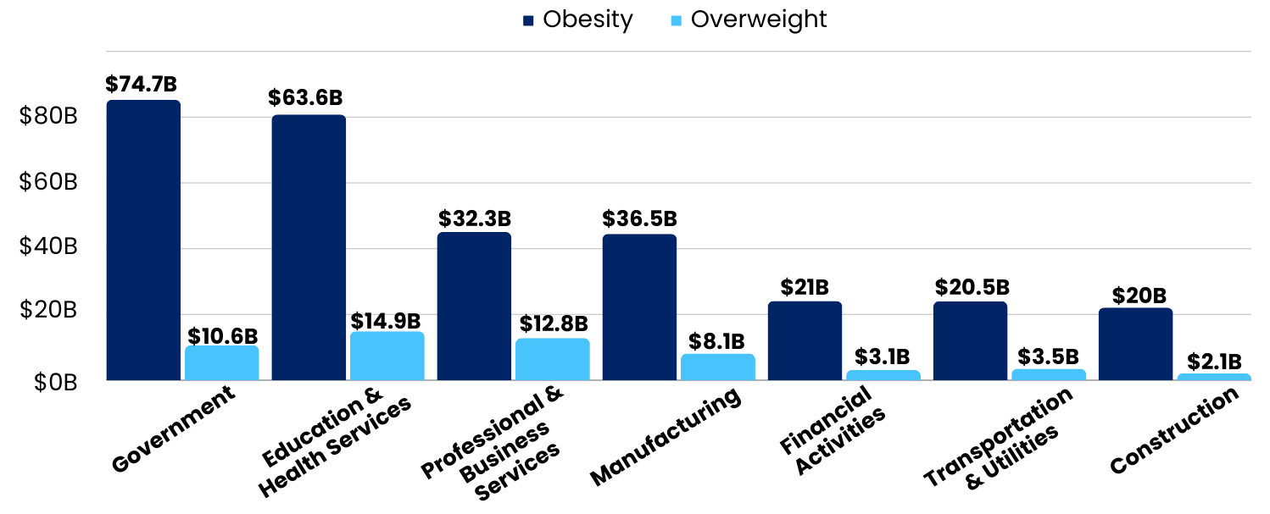
Appendix I: Economic Impact of Excess Body Weight For Select Industries
The economic impact differs by industry based on obesity prevalence, demographics, industry-specific risks, and socioeconomic factors
Potential Medical Industry Savings

