Slide 1
Obesity's Impact on Illinois’ Economy and Labor Force
Supported by Eli Lilly and Company
March 2024
See the full report at:
https://www.globaldata.com/health-economics/US/Illinois/Obesity-Impact-on-Illinois.pdf

Slide 2
Economic, Workforce, and State Budget Implications of Excess Weight in Illinois: 2022
Reduced economic activity by $17.6B (1.7%)
$1.6B in higher work absenteeism and disability costs
145,900 fewer adults in the workforce
Negative $2.4B budget implications for Illinois (3.6% of FY 2022 revenues)
Increased Medicaid, public assistance, & state government health insurance costs by $1B
Reduced state tax revenues by $1.4B (2.1%)
Money currently spent on healthcare that could be redirected to other purposes
$1.2B in spending by households
$2.1B in spending by employers
$3.7B in federal Medicare and Medicaid spending

Slide 3
COST OF OBESITY ON ILLINOISANS
Reduced Earnings for Employed Women
Lower Labor Force Participation
Higher Medical Costs to Households
Increased Mortality
Women with obesity earn 9% less than women with healthy weight
Odds of employment are lower for men (0.93) and women (0.80) with obesity compared to peers with healthy weight
Increased healthcare costs associated with obesity and overweight
Estimated premature deaths occur
19,000
Year
822,400 employed women with obesity
$2,396
Obesity
$220
Overweight
100,300 fewer adults with obesity working
relative to the healthy weight population
Resulting in:
Medical costs compared to adults with healthy weight
$3.4B
$169.1M
$2.6B
reduced earnings
lower state GDP
lower state income tax receipts
$1.2B
Higher spending by households
$5.5B
reduced earnings
**Obesity appears to have no effect on earnings of employed adult males

Slide 4
COST OF OBESITY ON EMPLOYERS
Higher Absenteeism & Disability Costs
Higher Healthcare Costs
Recommendations
Employers can increase treatment access by…
1.8M employed adults with obesity in Indiana
Higher costs attributed to obesity & overweight
Offering insurance coverage and wellness programs for obesity care at parity with other chronic diseases
$840
$2,396
$2.1B
higher costs state-wide
Fostering support and inclusion that accommodates the needs of employees with obesity
Higher Medical Costs
Per employee with obesity
$220
$1.5B higher costs state-wide
Providing education and resources to employees to educate employees
Overweight
Obesity
Between 5%-25% weight loss among adults age <65 over 10 years has potential to save $7B-$22B in medical costs
Potential Medical Savings

Slide 5
COST OF OBESITY ON STATE & LOCAL GOVERNMENT
Increased Medicaid Spending
Increased Healthcare Costs for Employees
Increased Public Assistance Program Costs
Recommendations
State legislators can increase treatment access by…
State incurred higher Medicaid costs in 2022 by
100,300
Adults
Maintaining coverage for comprehensive obesity treatment for people covered under the State Employees Group Insurance Program
State and local government employees
679,000
Adults with obesity-attributed unemployment
6.7%
$661.1M
Employees participating in insurance
78%
Finalizing Medicaid coverage for obesity treatment
17,300
Adults
Medicaid beneficiaries with
Overweight & Obesity
$625
Additional costs
$331M
Higher costs
For state & local government employee healthcare
Public assistance program participants
Investing in community-based programs and education campaigns
29.8%
35.1%
per covered employee
$55.8M in higher state & local public assistance costs

Slide 6
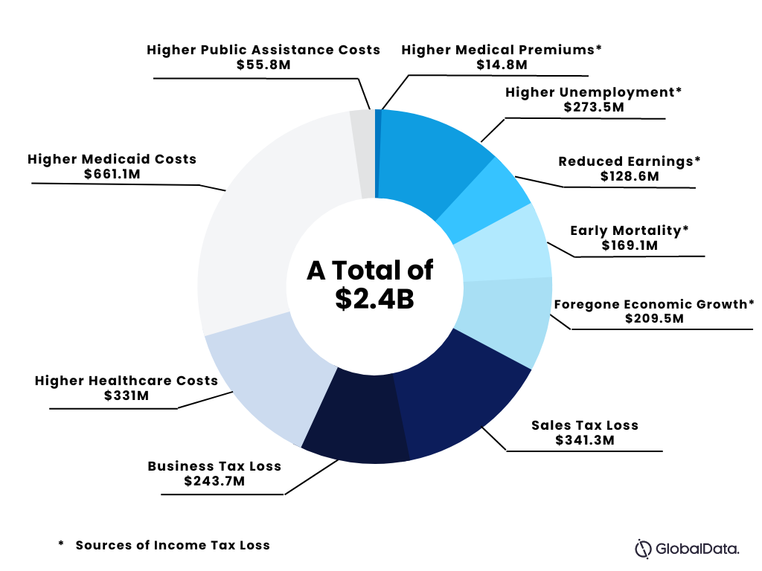
STATE BUDGET IMPLICATIONS
Notes:
Budget with a few bullets about tax losses and higher costs

